Slide 1

University College Of Engineering & Technology (UCET) Vinoba Bhave University, Hazaribagh (825301)
PPT Presentation on
Solar geoengineering fight against climate change
-Presented By
Priyanshu Raj
ROLL NO :-2009150
BRANCH :-CSE(1st Sem)
SESSION :-2020-2024

Slide 2
What is solar geoengineering:-
Solar geoengineering—also referred to as solar radiation management—describes a set of proposed approaches to reflect sunlight to rapidly cool the Earth.
Within solar geoengineering, researchers are considering two main approaches. The first—stratospheric aerosol injection, or SAI—would involve injecting tiny reflecting particles, known as aerosols, into the upper atmosphere to cool the planet. The second—marine cloud brightening, or MCB—would use sea salt to stimulate cloud formation over the ocean, which would also help reflect sunlight in the region.

Slide 3
If ever deployed, SAI would have global impacts, reducing temperatures and altering precipitation patterns across the planet.
MCB would involve spraying sea salt into low-lying marine clouds to enhance their brightness and reflectivity in order to increase regional-scale cooling. Researchers have been examining the risks and benefits of solar geoengineering through computer modeling and observational studies for several years.
This research has been valuable in gaining a deeper understanding of the possible consequences of solar geoengineering. But many questions remain unanswered, including whether and how solar geoengineering might ever be responsibly governed.

Slide 4
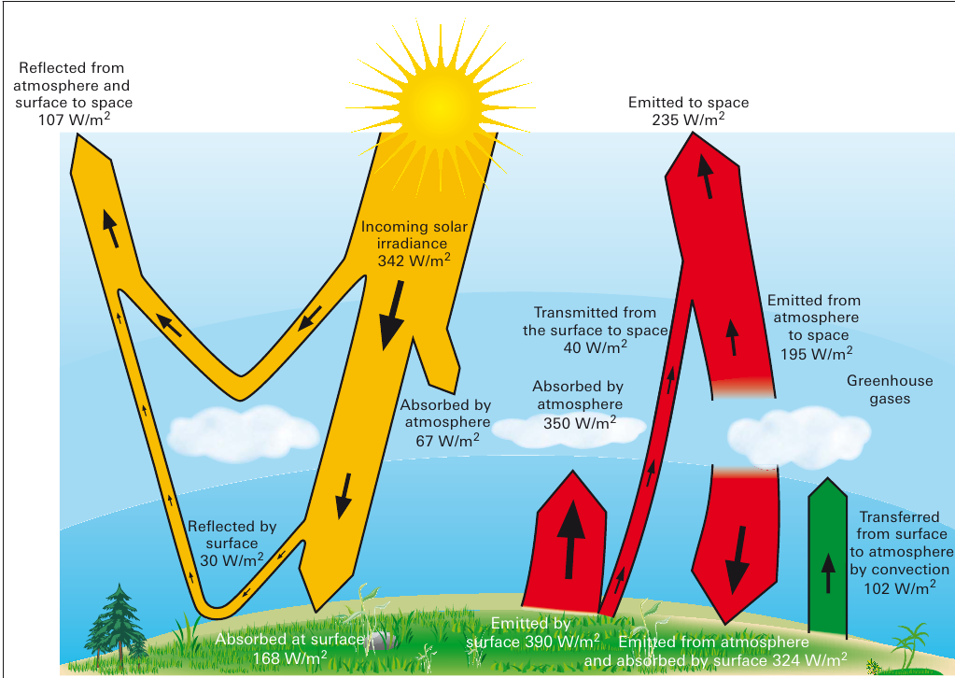

Slide 5
Geoengineering Strategies :-
Climate Engineering
Carbon Dioxide Removal (CDR)
Solar Radiation Management (SRM)
Alkalization of the ocean (limestone)
Actually adaptation, but considered climate engineering in the literature and research
Adaptation
Levees
Coastal Restoration
Riverine Drainage Projects
Water Relocation Projects

Slide 6
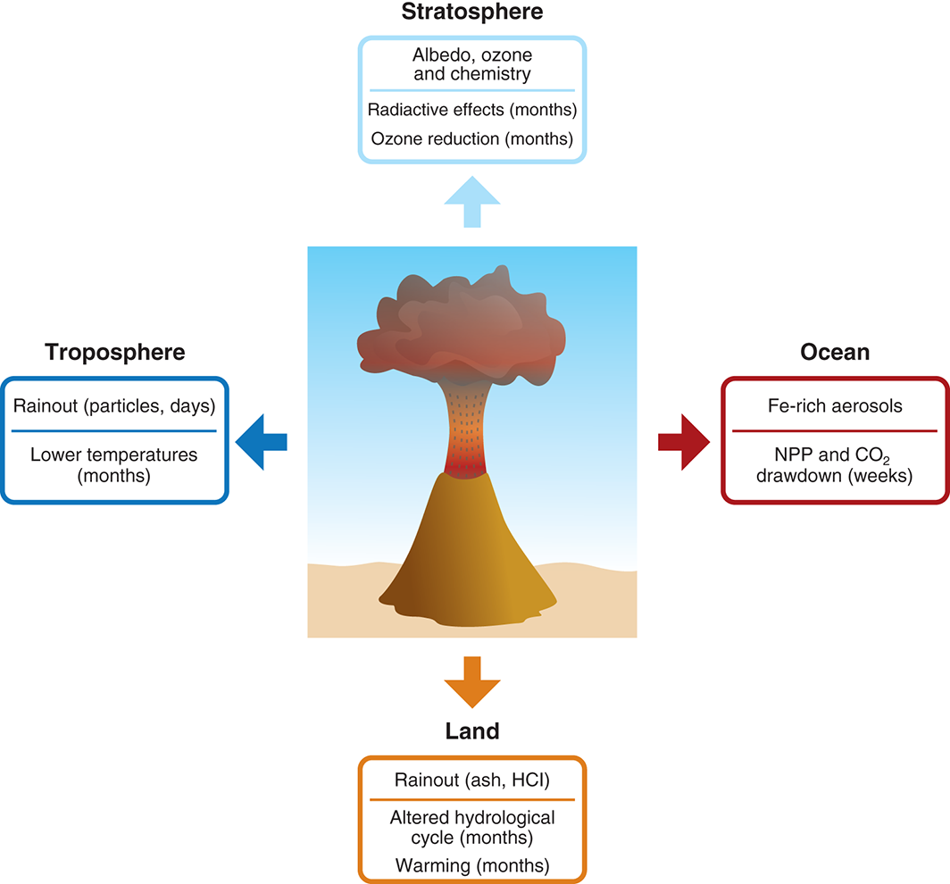
Natural Climate Engineering

Slide 7
Why the Explosion of Interest?
Ramp up of projected risks from warming such as sea level rise.
Growing concern with tipping points
Impossibly of creating binding and enforceable international agreements
Limits of the Paris agreement
Growing subnational resistance in the US
Election of Trump
E.P.A. Chief rejects consensus view of climate change

Slide 8
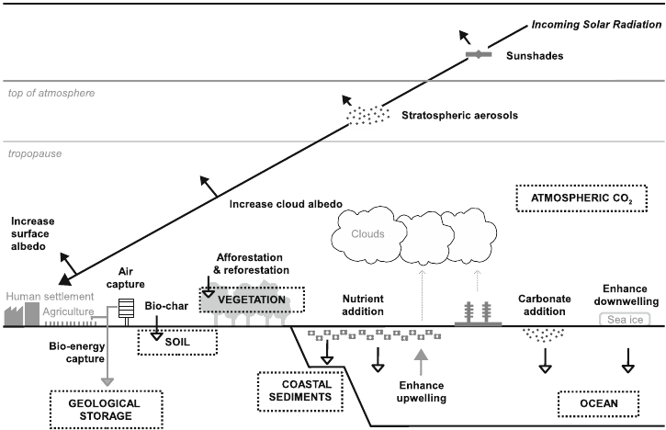

Slide 9
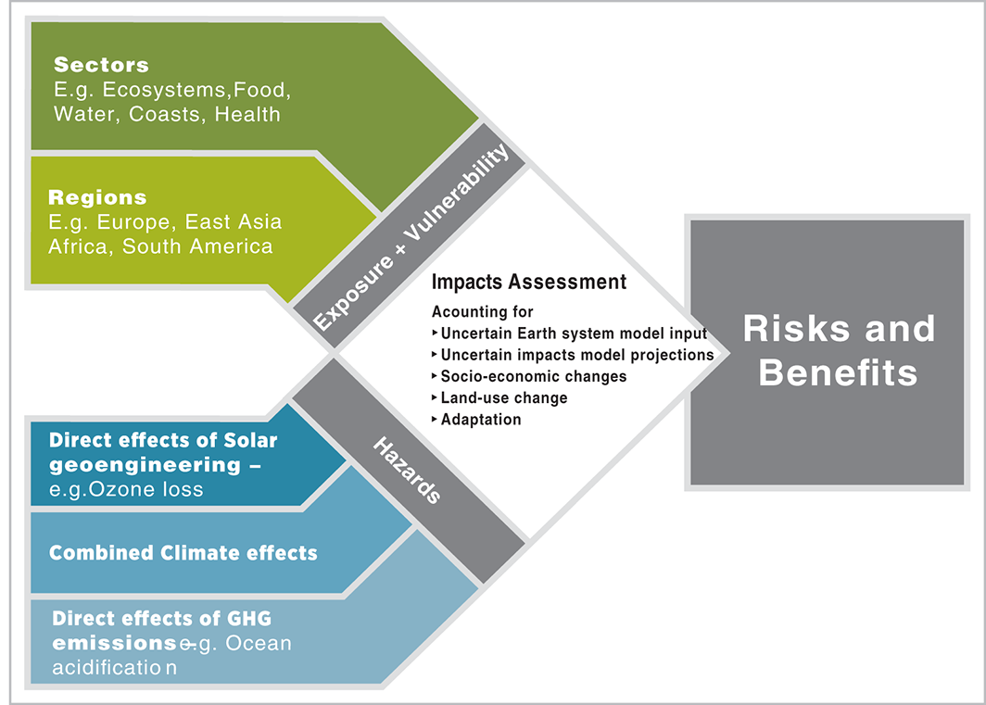
Towards a comprehensive climate impacts assessment of solar geoengineering

Slide 10
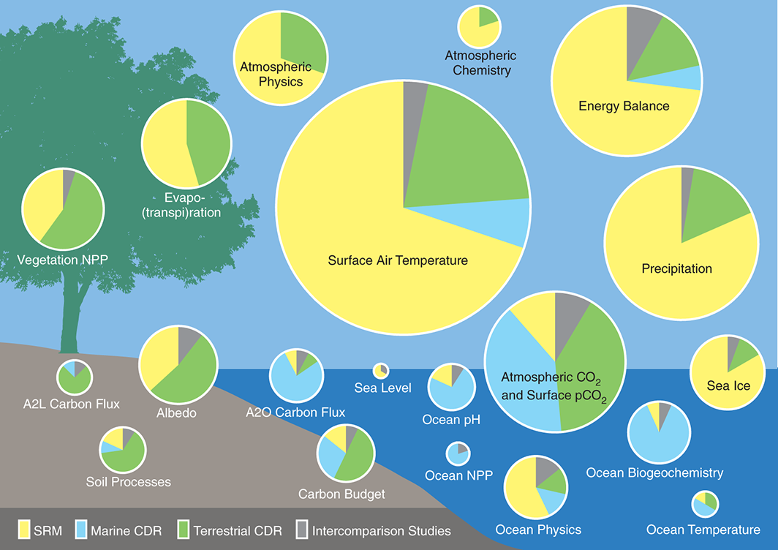
Indicators and metrics for the assessment of climate engineering

Slide 12
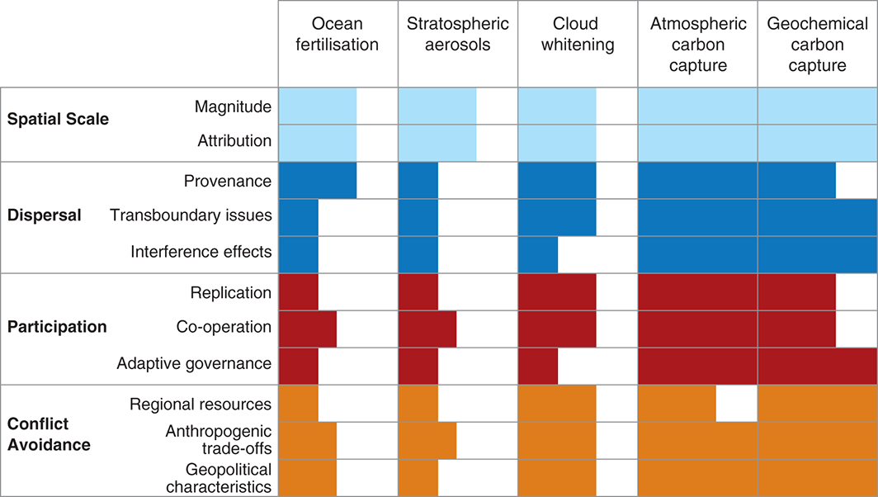
What are the Geopolitical Issues?

Slide 13
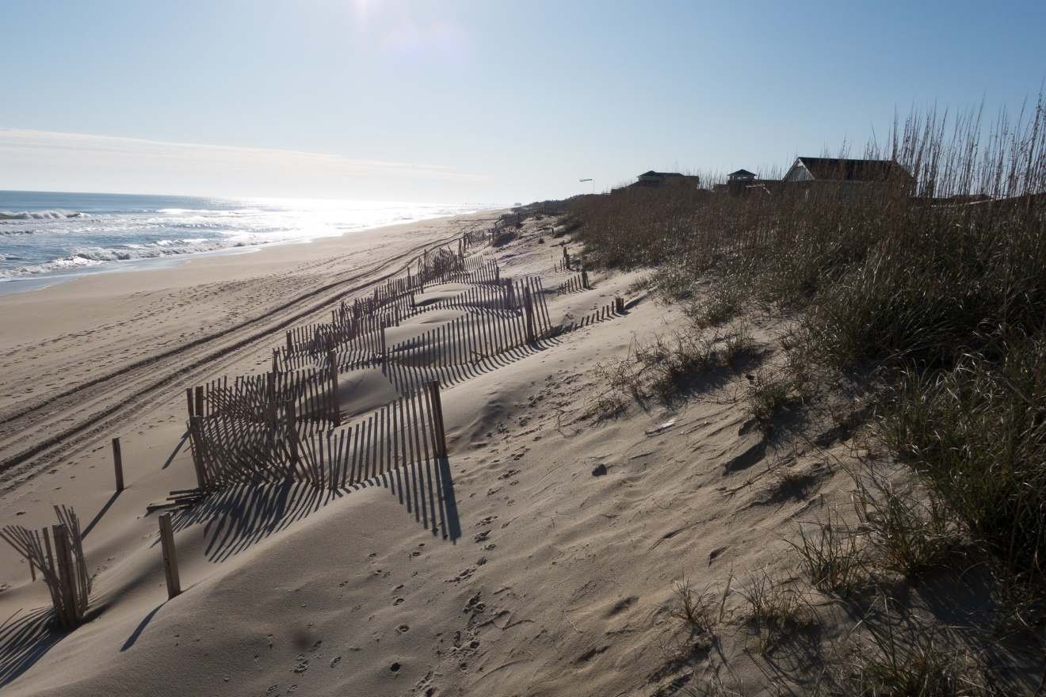
Dune Restoration – Outer Banks

Slide 14
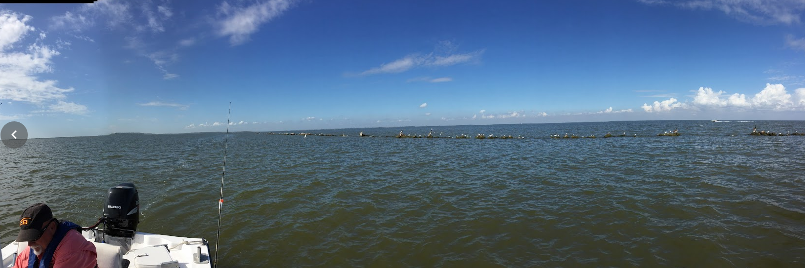
Living Shoreline - Louisiana

Slide 15
Why is Coastal Restoration Impossible?
Coasts retreat inland during sea level rise
Deep paleoclimate/geology record
Current rates of sea level rise are enough to force retreat, and projected rates exceed previous natural rates.
Deltas follow sea level
Retreat inland during rising sea level – all are about 6k years old
Go to the continental shelf during glacial maximum
Coastal restoration denies the effects of climate change.

Slide 16
The Risks of Coastal Restoration
The escalator effect from creating a false sense of security, especially for wetlands creation, which does not reduce major storm surge
Hastened destruction of the existing ecology systems
Huge carbon footprint for dredging projects
Most of the cost is fuel
All are must be continually repeated
Shifts money away from real protection and long term relocation.

Slide 17
Thank You!

